Slide 1
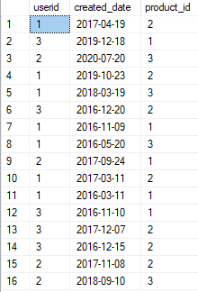



SQL Zomato Analysis
Sales Table
Product Table
Gold-signup users Table
bnb
Users Table

Slide 2


SQL Zomato Analysis
SELECT a.userid, SUM(b.price) AS total_amt_spent
FROM sales a
INNER JOIN product b ON a.product_id = b.product_id
GROUP BY a.userid;
What is the total amount each customer spent on zomato?

Slide 3

SQL Zomato Analysis
SELECT userid, COUNT(DISTINCT created_date) distinct_days FROM sales GROUP BY userid;
How many days has each customer visited zomato

Slide 4

SQL Zomato Analysis
SELECT *
FROM (
SELECT *, RANK() OVER (PARTITION BY userid ORDER BY created_date) AS product_rank
FROM sales
) a
WHERE product_rank = 1;
What was the first product purchased by each customer?

Slide 5

SQL Zomato Analysis
WITH MostPurchasedProduct AS (
SELECT TOP 1 product_id
FROM sales
GROUP BY product_id
ORDER BY COUNT(product_id) DESC
)
SELECT userid, product_id, COUNT(product_id) AS product_cnt
FROM sales
WHERE product_id = (SELECT product_id FROM MostPurchasedProduct)
GROUP BY userid, product_id;
What is the most purchased item on the menu and how many times was it purchased by all customers?

Slide 6

SQL Zomato Analysis
SELECT userid, product_id, cnt, rnk
FROM (
SELECT userid, product_id, COUNT(product_id) AS cnt,
RANK() OVER (PARTITION BY userid ORDER BY COUNT(product_id) DESC) AS rnk
FROM sales
GROUP BY userid, product_id
) AS ranked_sales
WHERE rnk = 1;
Which item was the most popular for each customer?

Slide 7

SQL Zomato Analysis
SELECT *
FROM (
SELECT s.userid, s.created_date, s.product_id, g.gold_signup_date,
RANK() OVER (PARTITION BY s.userid ORDER BY s.created_date) AS rnk
FROM sales s
INNER JOIN goldusers_signup g
ON s.userid = g.userid
AND s.created_date >= g.gold_signup_date
) AS ranked_purchases
WHERE rnk = 1;
Which item was purchased first by the customer after they became a member?

Slide 8

SQL Zomato Analysis
SELECT *
FROM (
SELECT s.userid, s.created_date, s.product_id, g.gold_signup_date,
RANK() OVER (PARTITION BY s.userid ORDER BY s.created_date DESC) AS rnk
FROM sales s
INNER JOIN goldusers_signup g
ON s.userid = g.userid
AND s.created_date <= g.gold_signup_date
) AS ranked_purchases
WHERE rnk = 1;
Which item was purchased just before the customer become a member?

Slide 9

SQL Zomato Analysis
SELECT p.userid, COUNT(p.created_date) AS order_purchased, SUM(p.price) AS total_amt_spent
FROM (
SELECT s.userid, s.created_date, s.product_id, d.price
FROM sales s
INNER JOIN goldusers_signup g
ON s.userid = g.userid
AND s.created_date <= g.gold_signup_date
INNER JOIN product d
ON s.product_id = d.product_id
) AS p
GROUP BY p.userid;
What are the total orders and amount spent for each member before they became a member

Slide 10

SQL Zomato Analysis
WITH PointsPerProduct AS (
SELECT s.userid, s.product_id, SUM(p.price) AS amt,
CASE
WHEN s.product_id = 1 THEN SUM(p.price) * (1.0 / 5) -- For product 1: 1 point per ₹5
WHEN s.product_id = 2 THEN SUM(p.price) * (5.0 / 10) -- For product 2: 5 points per ₹10
WHEN s.product_id = 3 THEN SUM(p.price) * (5.0 / 5) -- For product 3: 5 points per ₹5
ELSE 0
END AS total_points
FROM sales s
INNER JOIN product p
ON s.product_id = p.product_id
GROUP BY s.userid, s.product_id
),
TotalPointsPerUser AS (
SELECT userid, SUM(total_points) * 2.5 AS total_cashbacks_earned
FROM PointsPerProduct
GROUP BY userid
),
MostPointsPerProduct AS (
SELECT product_id, SUM(total_points) AS total_points_per_product
FROM PointsPerProduct
GROUP BY product_id
)
SELECT userid, total_cashbacks_earned, product_id, total_points_per_product
FROM TotalPointsPerUser
CROSS APPLY (
SELECT TOP 1 product_id, total_points_per_product
FROM MostPointsPerProduct
ORDER BY total_points_per_product DESC
) AS MostPoints;
How many Zomato points has each customer accumulated, considering that the points vary by product (e.g., for product P1, ₹5 = 1 Zomato point, and for product P2, ₹10 = 5 Zomato points)? Additionally, which product has contributed the highest number of total Zomato points across all customers?

Slide 11

SQL Zomato Analysis
SELECT c.*,d.price*0.5 total_points_earned FROM
(SELECT s.userid, s.created_date, s.product_id, g.gold_signup_date
FROM sales s
INNER JOIN goldusers_signup g
ON s.userid = g.userid
AND s.created_date >= g.gold_signup_date
AND s.created_date<= DATEADD(year, 1, g.gold_signup_date))c
INNER JOIN product d on c.product_id = d.product_id;
In the first year after a customer joins the Zomato Gold program (including the join date), where they earn 5 Zomato points for every ₹10 spent regardless of the items purchased, which customer—User 1 or User 3—earned more points? Additionally, what were their total Zomato points earnings in the first year, considering that 1 Zomato point equals ₹2 (i.e., 0.5 Zomato point equals ₹1)?

Slide 12
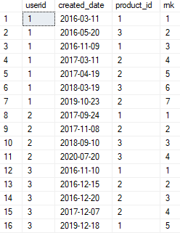
SQL Zomato Analysis
SELECT *, RANK() OVER(PARTITION BY userid order by created_date) as rnk FROM sales;
Rank all transaction of the customers

Slide 13
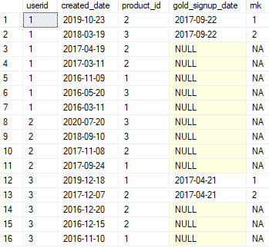
SQL Zomato Analysis
SELECT a.*,
CASE
WHEN gold_signup_date IS NULL THEN 'NA'
ELSE CAST(RANK() OVER(PARTITION BY userid ORDER BY created_date DESC) AS VARCHAR)
END AS rnk
FROM (
SELECT s.userid, s.created_date, s.product_id, g.gold_signup_date
FROM sales s
LEFT JOIN goldusers_signup g
ON s.userid = g.userid
AND s.created_date >= g.gold_signup_date
) a;
Rank all transactions for each Zomato Gold member during their membership period, while marking the transactions for non-Gold members as 'NA'? This will allow us to track the activity of Gold members and differentiate it from non-members.

